Slide 1

Research Methodology
Sample Design
Prof. Raghu Rao + Inputs by Dr. Arti Arya
Department of Computer Science and Engineering

Slide 2

Research Methodology
Sample Design
Prof. Raghu Rao + Inputs by Dr. Arti Arya
Computer Science and Engineering

Slide 3
Research Methodology
Disclaimer
These slides are prepared from the prescribed text book and other reliable resources from the Internet.
The images are imported from various sites and videos are imported from youtube.com

Slide 4
INTRODUCTION
Objects in field of enquiry – Universe / Population
Enumeration of all items in population = Census Survey.
Ex: Avg monthly income of people of India
When all objects are covered -> highest accuracy
Possible? Cost, Bias?
Census is impossible in situation where population is infinite.
Sample is selecting a few objects
Sampling Technique is a way of selecting a sample.

Slide 5
INTRODUCTION
A sample is “a smaller (but must be a representative) collection of units from a population used to determine truths about that population” (Field, 2005)
The sampling frame A list of all elements or other units containing the elements in a population.

Slide 6
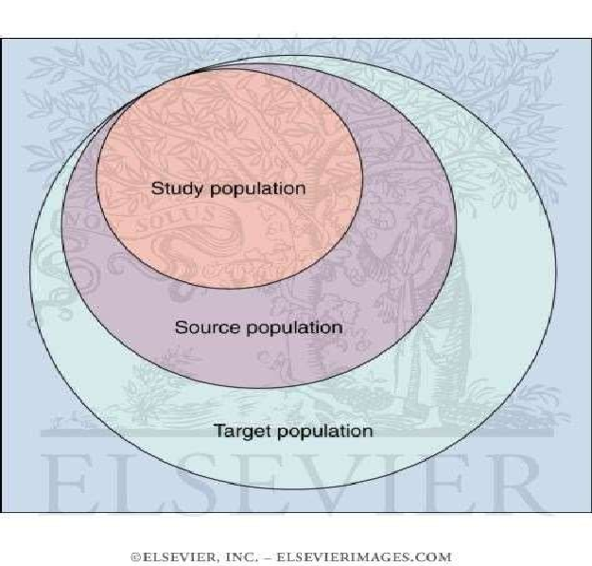
POPULATION
The larger group from which individuals are selected to participate in a study
TARGET POPULATION
A set of objects larger than or different from the population sampled and to which the researcher would like to generalize study findings.

Slide 7
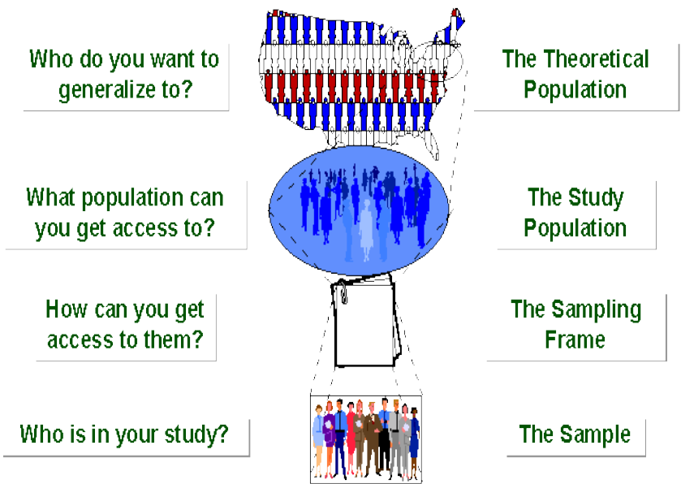
POPULATION TO SAMPLE

Slide 8
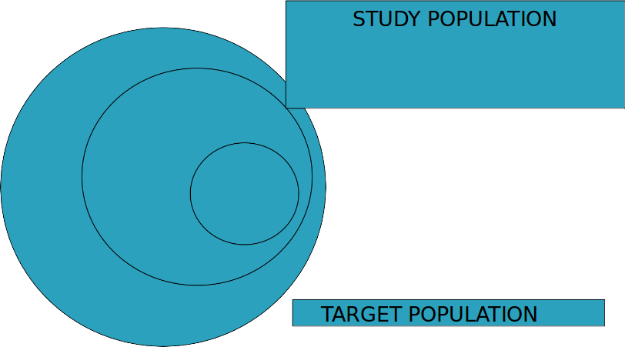
Research Methodology
Sampling
Definition: “The process of selecting a number of individuals for a study in such a way that the individuals represent the larger group from which they were selected.”
Sample

Slide 9
Research Methodology
Sample Design
Plan for obtaining sample from a population
Technique / procedure a researcher will adopt in selecting sample.
Sample design is detected before and after a sample is collected.

Slide 10
Research Methodology
Main Steps of Sampling
Objective
Population
Sampling Unit and Frame
Size of Sample
Parameter of Interest
Data Collection
Non respondents
Selection of proper sampling design
Organizing field work
Pilot Survey
Budgetary Constraints

Slide 11
Research Methodology
Main Steps of Sampling
Objective :
Define the objective of study. It should be in proportion with money, manpower and time.
Population (or Universe):
Should be clearly defined.
Sampling Units and Frames:
Sampling unit – for study
geographic unit – state, district, state or
construction unit – flat, house, or
social unit – house, flat
Source List – Sampling Frame

Slide 12
Research Methodology
Main Steps of Sampling
Size of Sample
Number of units to be selected.
Size should be neither too large nor too small
Optimal size –> efficiency, flexibility, reliability.
Parameters of Interest
Statistical constants of population – parameters.
Ex - mean population, population proportion

Slide 13
Research Methodology
Main Steps of Sampling
Data Collection:
Only relevant information to be collected.
Objective to be made clear
Non respondents
Because of practical difficulties, data may not be collected for all sampled units.
Non responses tend to change results

Slide 14
Research Methodology
Main Steps of Sampling
Selection of proper Sampling Design :
Must decide technique in selecting the items for sample.
Must yield less error
Organizing field work:
Success depends on reliable field work.
There should be efficient supervisory staff and trained personnel for field work.

Slide 15
Research Methodology
Main Steps of Sampling
Pilot Survey
Try research on small scale before going to field.
Budgetary Constraints
Cost consideration, from practical viewpoint.
Have major impact upon decision relating to not only size but also types of sample.
Organizing field work
Success depends on reliable field work

Slide 16
RESEARCH METHODOLOGY
Ch. 4: Sampling Design
Raghu B. A.
Department of Computer Science and Engineering

Slide 17
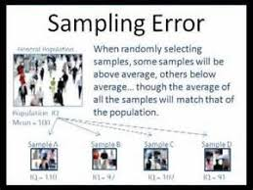
Research Methodology
Sampling Error
Only a part of population has been used for estimation and to draw inference.
Sampling errors are absent in census survey
Can be measured for a given size and sample design = precision of sampling plan.
If we increase the sample size, precision can be improved.
Also increases cost and systematic bias

Slide 18
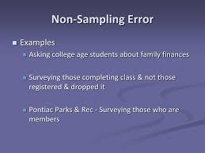
Research Methodology
Non-Sampling Error
Arises at the stage of collection and preparation of data.
Present in both sample & census survey
Can be reduced by defining the sampling unit, frame and population correctly.

Slide 19

SAMPLING TECHNIQUES

Slide 20
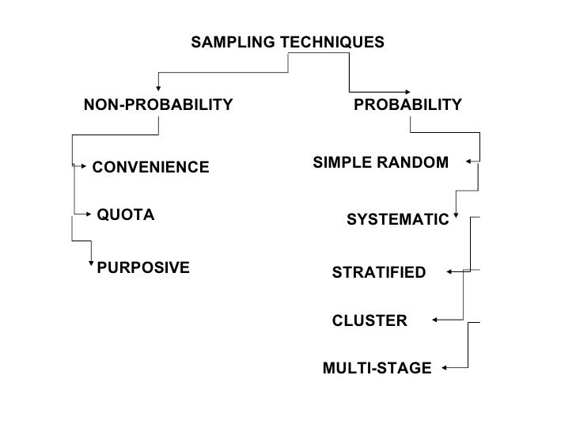
Research Methodology
Types of Sampling Design

Slide 21
Research Methodology
Types of Sampling Design
TYPES OF SAMPLING
PROBABILITY
Simple Random Sampling
NON- PROBABILITY
Quota Sampling
COMPLEX RANDOM
Systematic Sampling
Stratified Sampling
Cluster Sampling
Multistage Sampling
Sequential Sampling

Slide 22
Research Methodology
Simple Random Sampling
It is the purest form of probability sampling.
Each member of the finite population has an equal probability and known chance of being selected.
Sampling without replacement
When there are very large populations?
it is often difficult
impossible to identify every member of the population
The pool of available subjects becomes biased.
Examples :
Lottery or Fishbowl
Survey of insect population living in woodland
Trees no. 1 to 1200. 10 trees are chosen at random
Random number tables available [by Tippett, Yates, Fisher]

Slide 23
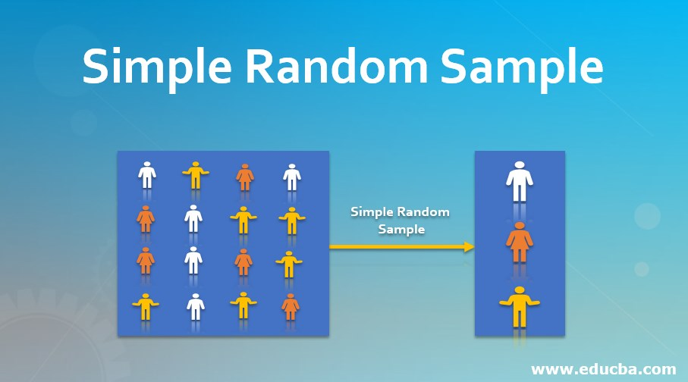
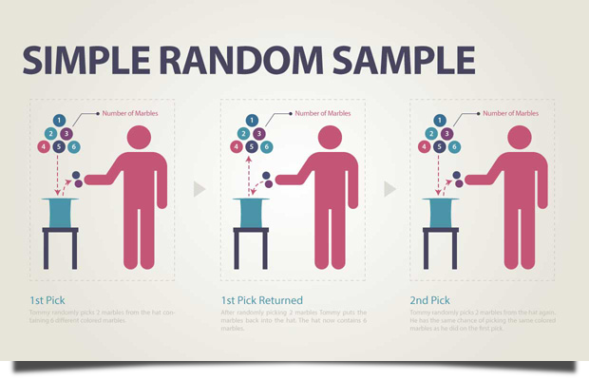
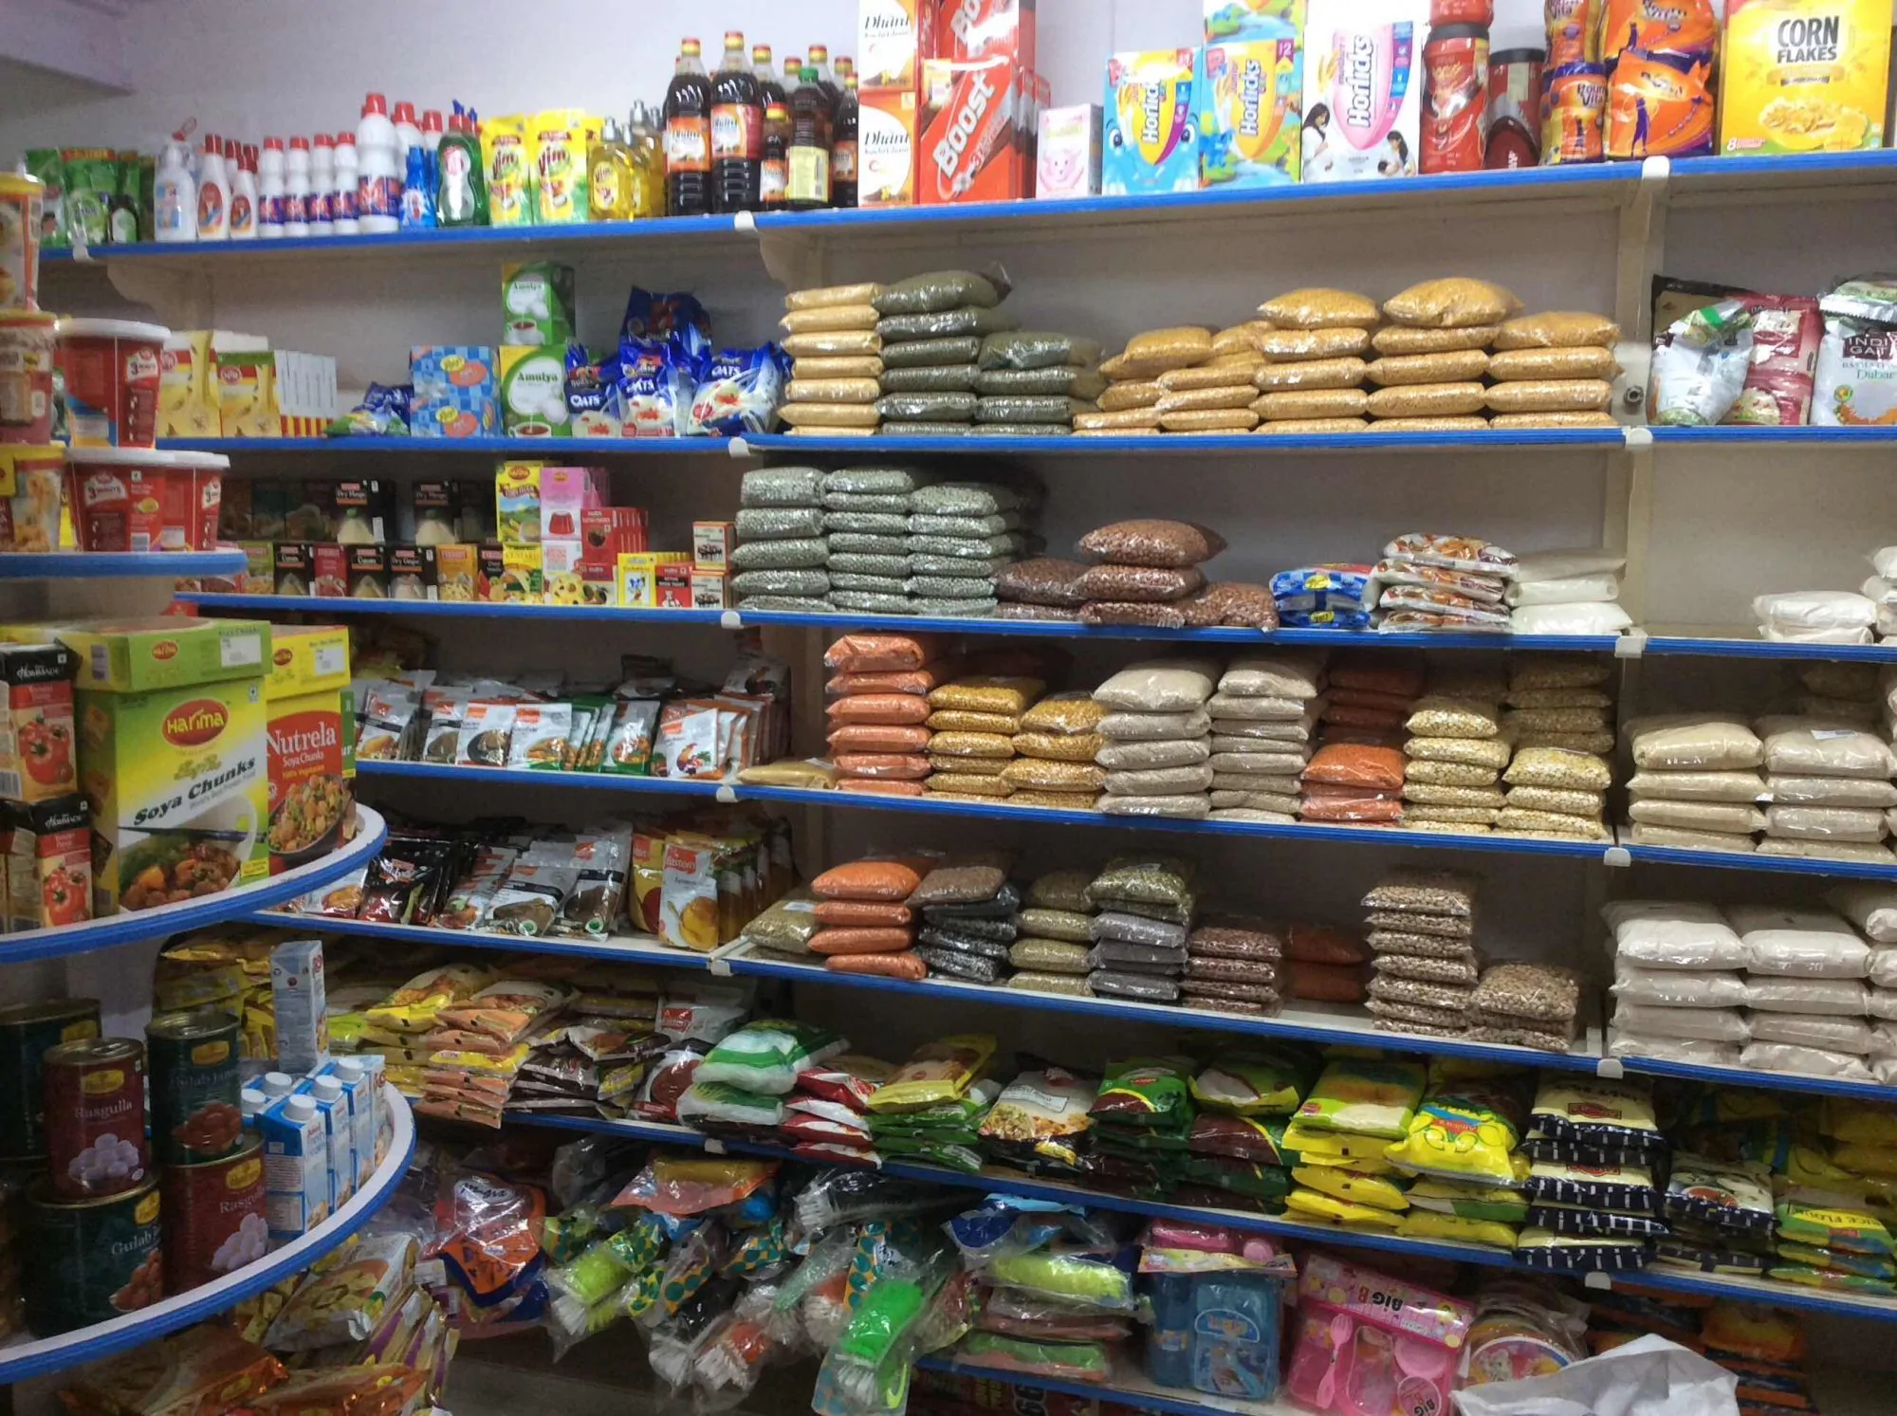
SIMPLE RANDOM SAMPLING

Slide 24
Research Methodology
Systematic Sampling
It is often used instead of random sampling.
It is also called an Nth name selection technique.
After the required sample size has been calculated, every Nth record is selected from a list of population members.
Randomness introduced in picking the start point.
As long as the list does not contain any hidden order, this sampling method is as good as the random sampling method.
It’s only advantage over the random sampling technique is simplicity, easy, cheap. And applicable for large populations.
Systematic sampling is frequently used to select a specified number of records from a computer file.

Slide 25
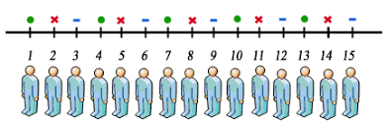
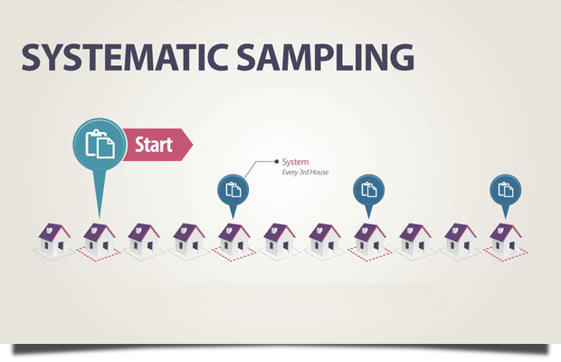
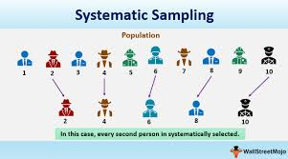
SYSTEMATIC SAMPLING

Slide 26
SYSTEMATIC SAMPLING
Example: to select a sample of 25 dorm rooms in your college hotel, make a list of all the room numbers in the dorm.
For example if there are 100 rooms.
divide the total number of rooms (100) by the number of rooms you want in the sample (25). The answer is 4.
This means that you are going to select every fourth dorm room from the list.
First of all, we have to determine the random starting point.
This step can be done by picking any point on the table of room numbers, and read across or down until you come to a number between 1 and 4. This is your random starting point.
For instance, your random starting point is "3". This means you select dorm room #3 as your first room, and then every fourth room down the list (3, 7, 11, 15, 19, etc.) until you have 25 rooms selected.

Slide 27
Research Methodology
Stratified Sampling
Chosen when sample to be drawn doesn’t constitute homogeneous group.
Population is divided into sub-populations that are individually homogeneous - strata
Stratified Sampling is possible when it makes sense to partition the population into groups based on a factor that may influence the variable that is being measured.
These groups are then called strata. Based on one or more characteristic.
An individual group is called a stratum. With stratified sampling one should:
partition the population into groups (strata)
obtain a simple random sample from each group (stratum)
collect data on each sampling unit that was randomly sampled from each group (stratum)
Called Stratified random sampling
Stratified sampling works best when a heterogeneous population is split into fairly homogeneous groups.

Slide 28
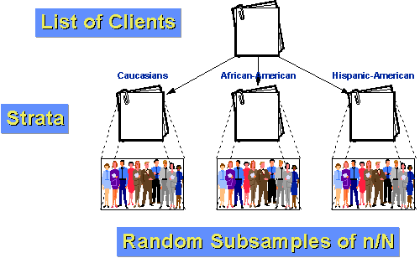
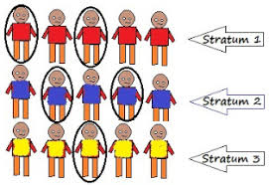
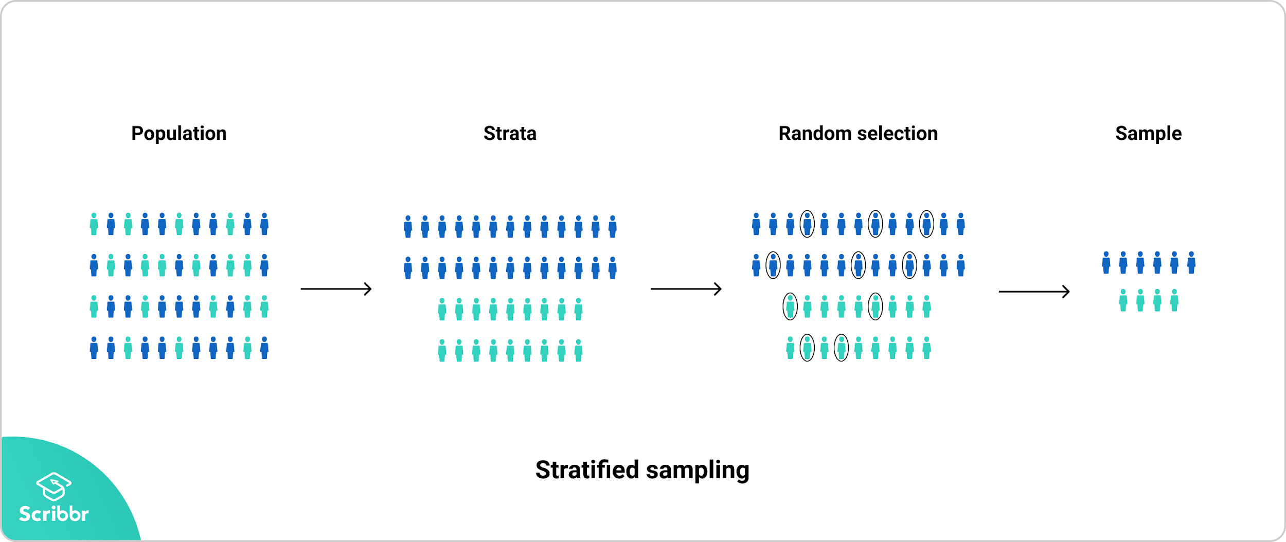
STRATIFIED SAMPLING

Slide 29
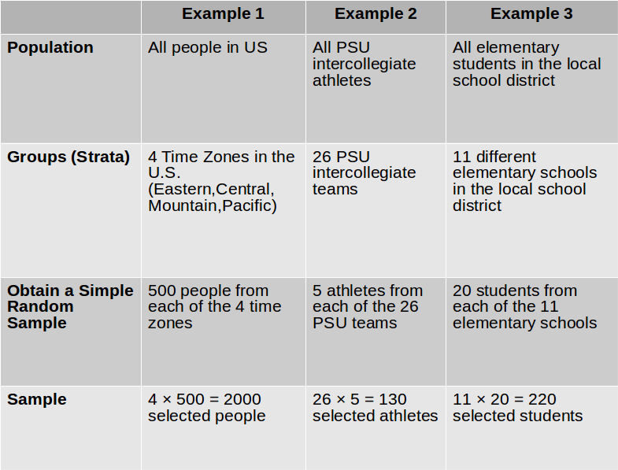
STRATIFIED SAMPLING

Slide 30
Research Methodology
Cluster Sampling
Used when population is divided into groups or clusters
Samples are selected from groups rather than individuals which is employed into large scale survey.
Advantages:
Very useful when population is spread over large geographic area.
Convenient and expedient
Does not need names of everyone in population.
Reduced cost
Disadvantages:
Representation is likely to become an issue
Less precise than random sampling.
If clusters (or groups/subdivisions) are geographic areas, then this is called Area Sampling.

Slide 31
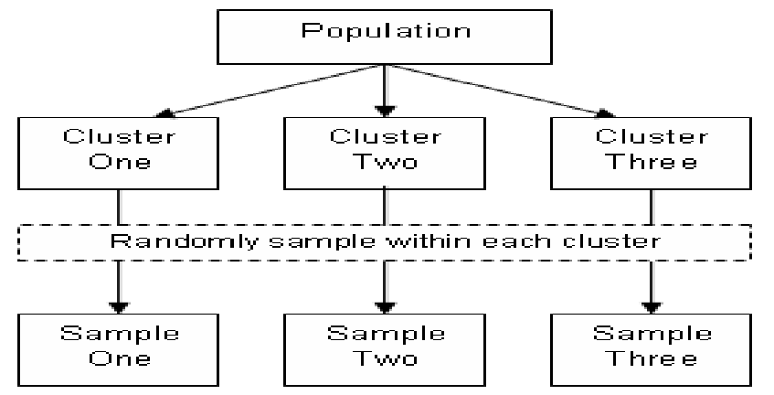
CLUSTER SAMPLING

Slide 32
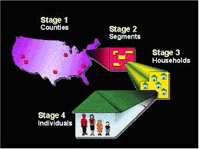
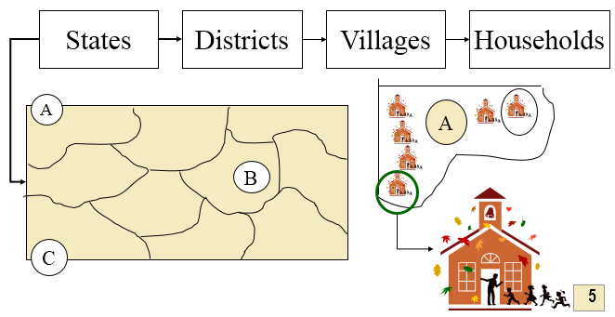
Research Methodology
Multistage Sampling
Selects samples using more than 1 sampling technique.
Complex - Hence rarely used.
Requires lot of effort, time & cost.

Slide 33
Research Methodology
Sequential Sampling
Complex Sample design
Size is not fixed in advance.
Adopted in case of acceptance sampling.
When a particular lot to be accepted / rejected on basis of single sample - single sampling
When decision taken on basis of 2 samples - double sampling
When number of samples are more than two, but neither certain nor decided in advance - Sequential Sampling

Slide 34
Research Methodology
Quota Sampling
This is a type of non probability sampling.
Population is divided into mutually exclusive sub groups as in stratified sampling.
Judgement is used to select the subject or unit from each segment based on specified portion.
Quota sampling is judgement samples rather than random samples.

Slide 35
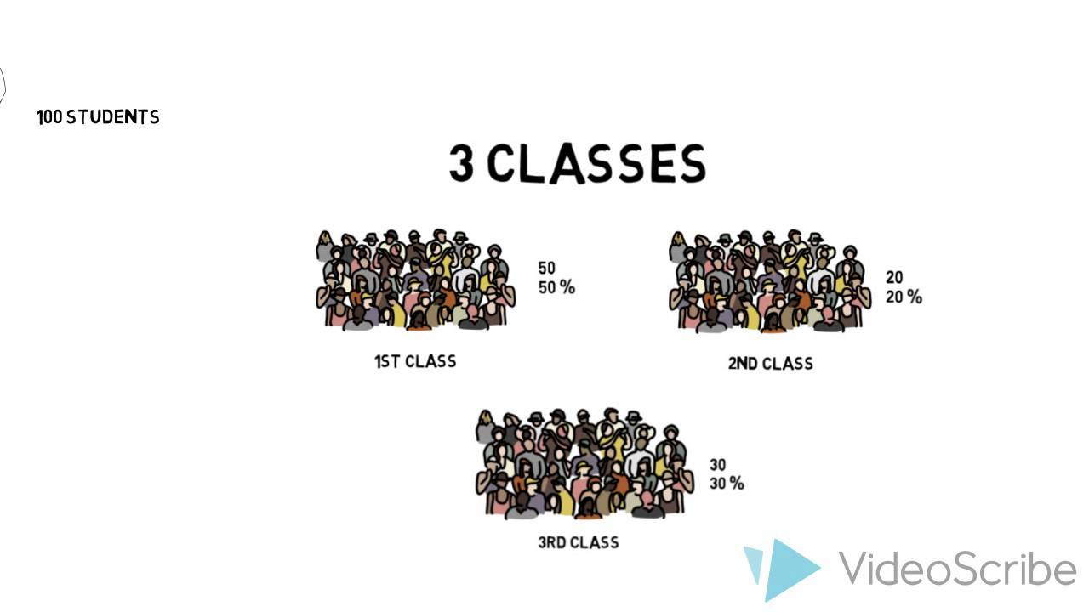

QUOTA SAMPLING

Slide 36
THANK YOU
Dr. Arti Arya
artiarya@pes.edu

